Slide 1


IMAGE SECURITY
(Encryption and Decryption)

Slide 2
Introduction
images are widely used in communication all over the world.
However, some images may refer to private personal or other commercial information
Image security should be paid much attention in order to combat illegal access, revision, and other attacks
Under the information era and the arrival of big data, we need a higher level of security protection for our images.

Slide 3
PROBLEM STATEMENT
there exists a probability of cracking the encryption resulting of breach of private information.
Because in information industry there is never enough security for data therefore how can we improve the security?

Slide 4

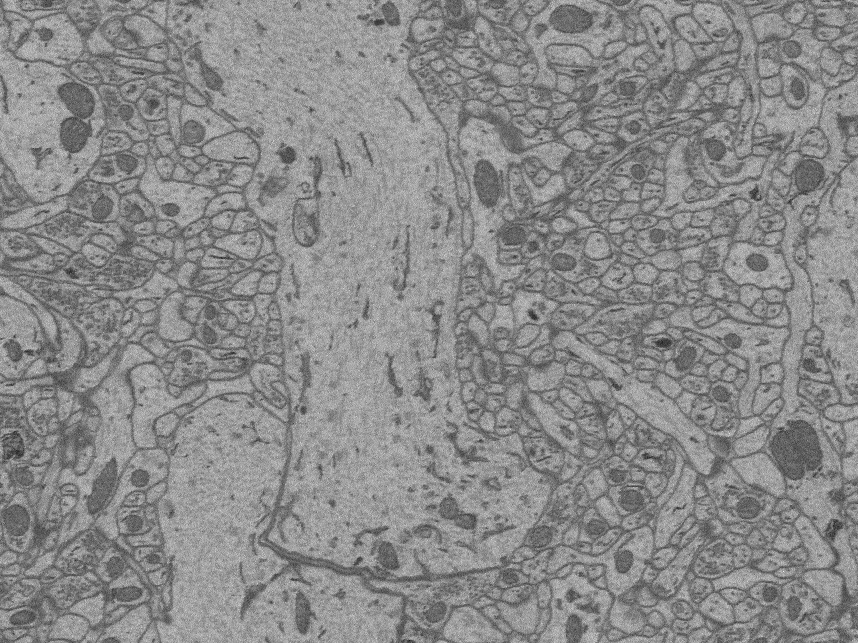
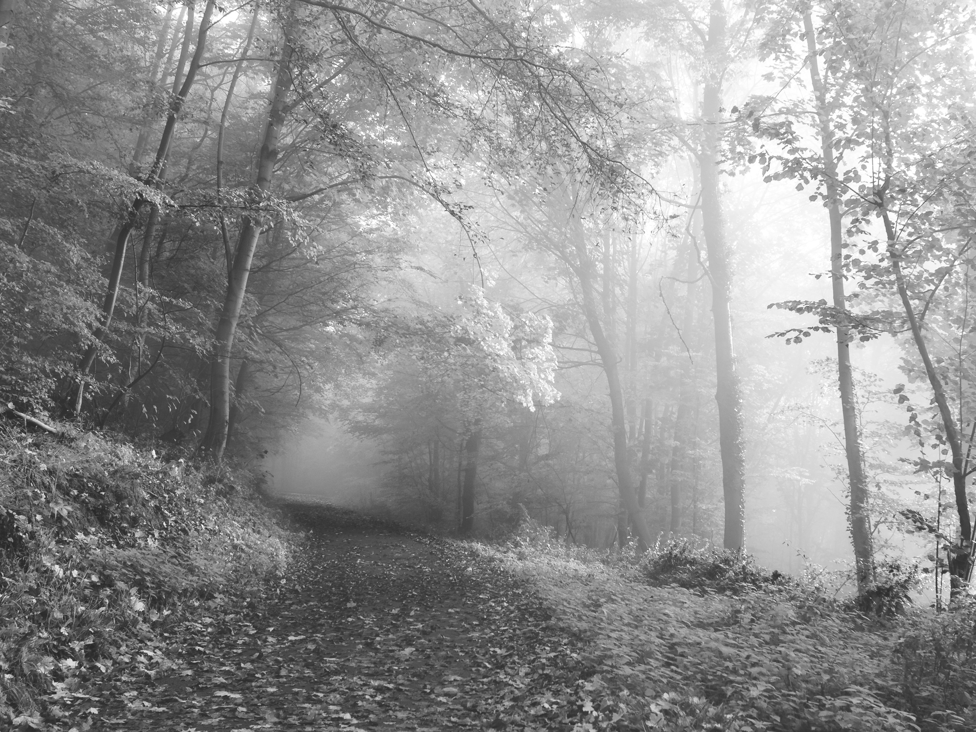
DATASET

Slide 5
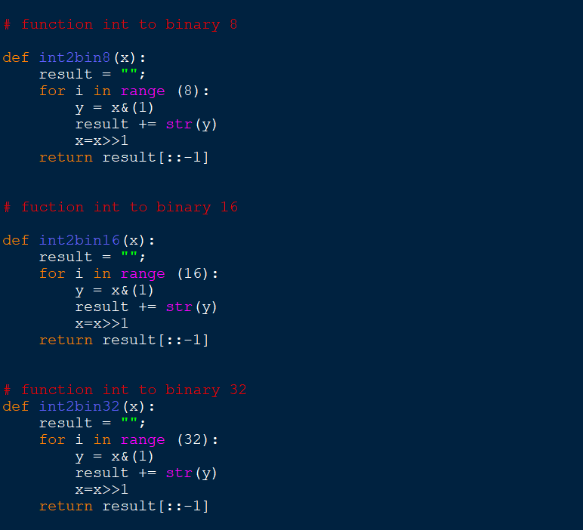
METHODOLOGY
Unit functions

Slide 6
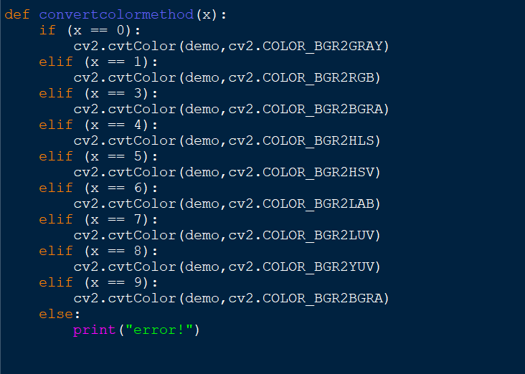
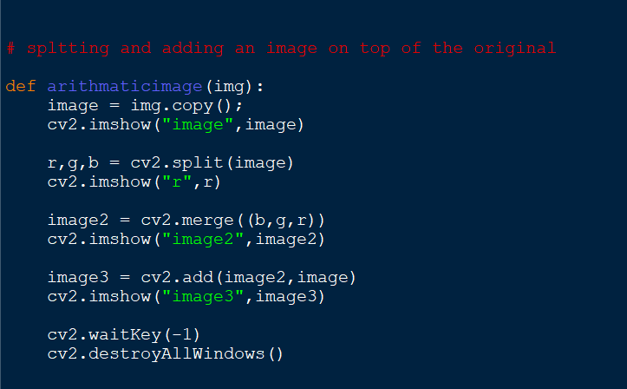

Slide 7
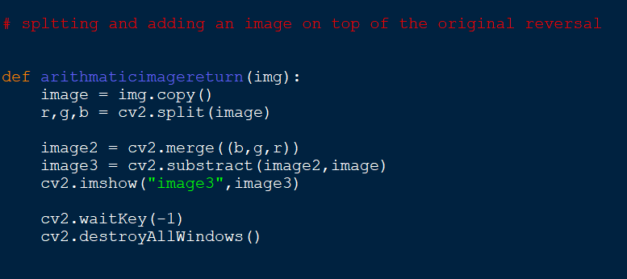
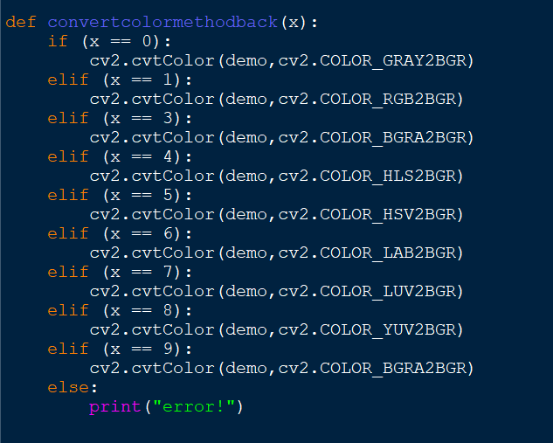

Slide 8
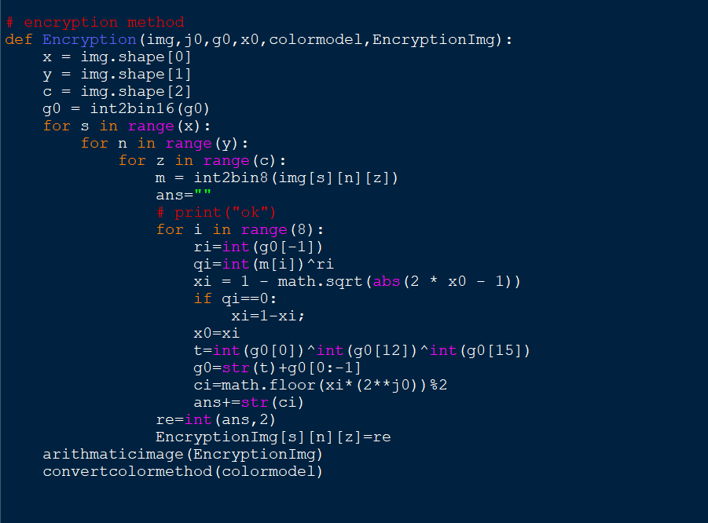
Encryption method

Slide 9
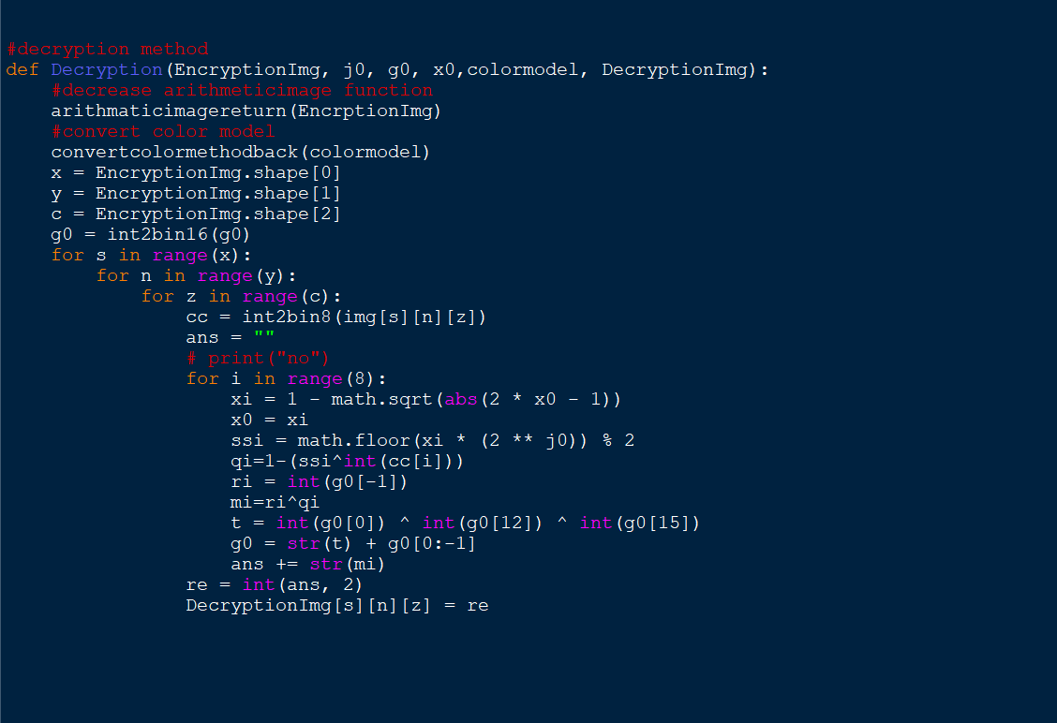
Decryption method

Slide 10

Encrypt an image and save

Slide 11
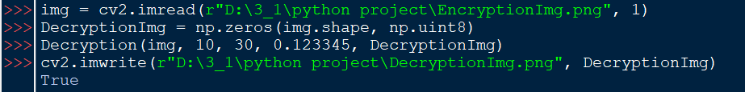
Decrypt the previously Encrypted image

Slide 12
RESULTS AND DISCUSSION
The problem addressed is achieved by combining mathematical operations and image processing operations for higher complicated encryption
This reduces the possibility of unauthorized access of information.
This application only works for .png images only.

